Slide 1
Smerge: Smarter Merge Conflict Resolutions
Alva Wei (alvawei) Jediah Conachan (jediah6)
Kenji Nicholson (kenjilee)
Steven Miller (stevenm62)
Sungmin Rhee (srhee4)

Slide 2
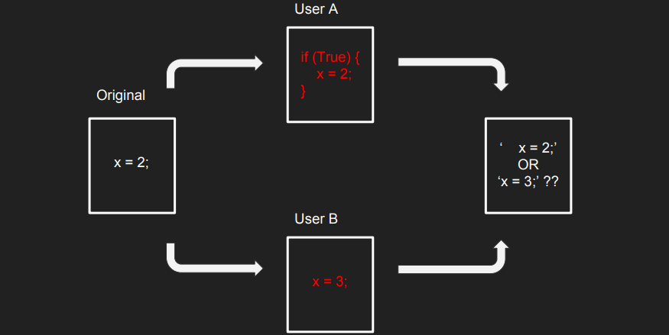
Motivation
Problem: Version control systems use line-based analysis to detect merge conflicts which results in many unnecessary manual merges
Manual merges = valuable developer time = more money spent on projects
Notes:
Version control systems use line-based analysis to detect merge conflicts which result in many unnecessary manual merge

Slide 3
Risks & Challenges So Far
Unsatisfactory merge would increase the user’s workload
User would need to revert the change and manually resolve merge
Balance between the amount of user input and the quality of merge
Minimize user input and maximize quality of merge

Slide 4
Goals
Make handling merge conflicts easier and require less time/money
Find a middle ground between automating merges and accepting input
Make giving input intuitive and faster
Implement a GUI
Reduce frequency of undesired behavior for merges that are automated

Slide 5
Current Approaches
Two categories:
Conservative approaches that require lots of user input
Time consuming to fill out the user input
If they don’t require as much user input, usually few conflicts are resolved
Examples: BitBucket, Git ‘ignore whitespace’
Fully automated approaches that require no input
Creates defective merges with undesired interleavings
Some merges lead to undesired behavior
Examples: Conflerge

Slide 6
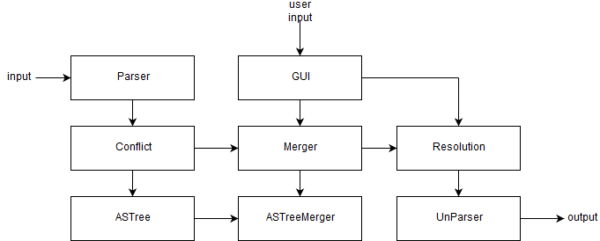
Approach
Input: git merge conflict via 2 conflicts
Parse input using JavaParser
Find conflicts in parsed code
Resolve with merger
ASTs & Mergers
GUI provides user input
Find resolution
Unparse back to code
Output: conflict resolution

Slide 7
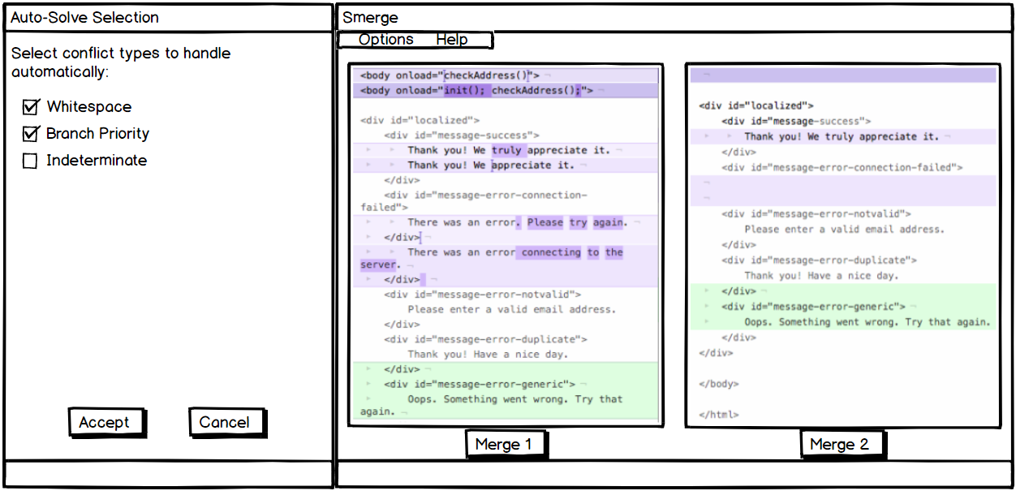
Approach (cont.)
GUI to take user inputs for better resolution
Auto-Solve Selection
Merge Confirmations w/ ‘Options’
Help tab opens user guide
Option tab opens auto-solve menu

Slide 8
Research
Question: How successful is Smerge at reducing conflicts?
Hypothesis: Smerge will reduce the number of merge conflicts experienced by the programmer
Procedure
Gather many GitHub repositories and their respective historical data
From the historical data, look for merge commits that have two or more parents
Use git’s standard merge tools on the commits and record how many conflicts arise
Use other tools on the commits and record how many conflicts arise
Use Smerge’s merging algorithm and record how many conflicts arise
Compare and contrast the human resolution to the conflict with Smerge’s merge resolution

Slide 9
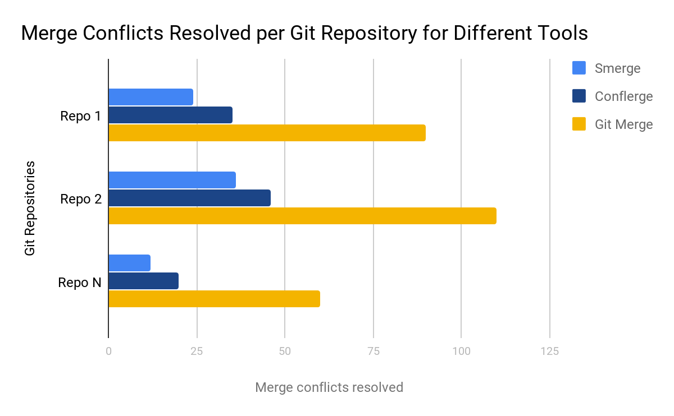
Research (cont.)
Data Collection
Conclusions
If Smerge has less conflicts than competitors, we will have succeeded
Validity Threats
Sample selection bias
We select a small # of repos
GUI intuitiveness is subjective
Not everyone will like it

Slide 10
Related works
Bitbucket
Resolves all conflicts by branch prioritizing
Possible undesirable merges
Works similarly to Github
Opposite to ours: Very conservative and requires manual action
Conflerge
Token-based merge and AST-based merge for fine-grain analysis
Automatically resolves merge conflict about 50% of the time
Either succeed or fail silently
Some defective merges
The project we’ll build off of

